Slide 1
Concurrent Operation of Wireless and Wired Power Transfer System with a Single Converter/Inverter
Enes Ayaz
^{19/10/2022}
Notes:
Hello, dear committee and colleagues.
I am enes ayaz; today, I will defend my thesis entitled
“Concurrent operation of Wireless power transfer-based contactless slip ring and motor drive system with a single converter. “

Slide 2
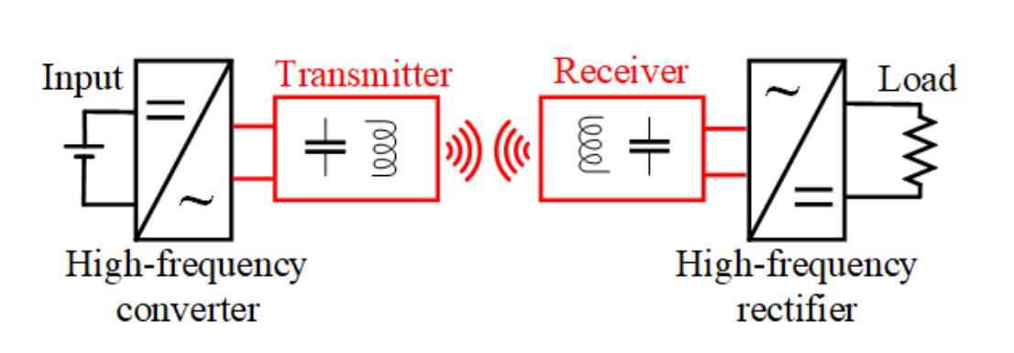
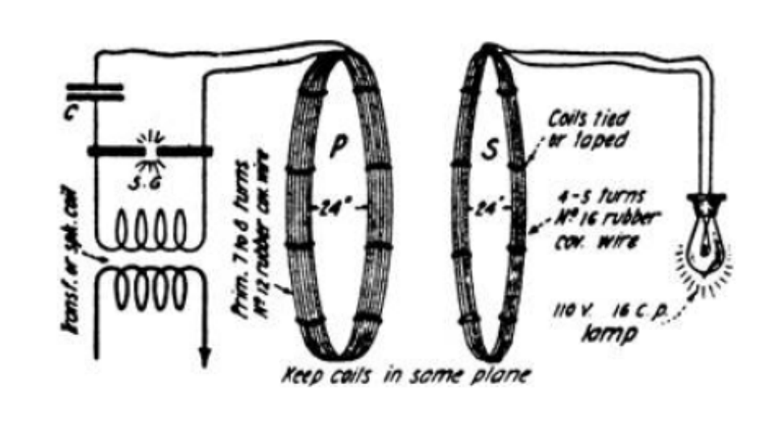
Wireless Power Transfer
DC/AC Converter
Compensation Circuits
Transmitter/Receiver Coils
AC/DC Rectifiers
 | Inductive Power Transfer | Capacitive Power Transfer
Transfer Type | Varying MF | Varying EF
Power Ratings | High | Low
Frequencies | Low | High
Efficiency | High | High
Distance | Moderate | Low
Tesla’s WPT System

Slide 3
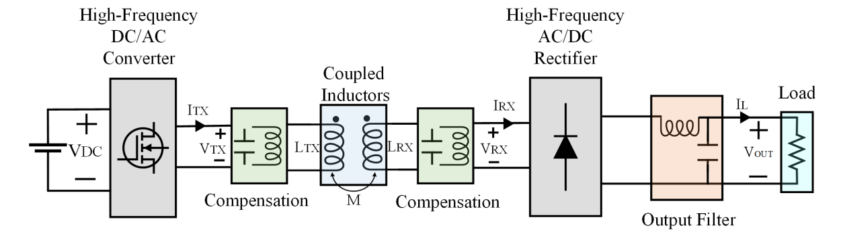
Inductive Power Transfer System
Notes:
This figure shows a block diagram of a conventional IPT system.
We have a high-frequency converter that generates a square wave voltage/current waveform.
Without compensation, the coupled inductors have a large leakage inductance, which inherently causes a low power factor.
We can use series or parallel capacitors to compensate for the leakage inductance.
The capacitors and coupled inductance create a resonant structure. Then, only the fundamental sinusoidal signal passes through the coupled coils.
The transmitted sinusoidal wave is rectified, and a ripple within DC exists.
The output capacitance and inductance filter out the ripple, and we achieve a DC output.

Slide 4
Look at Mendeley : PowerLab/Enes/WPT-Motor
Selective
Power Transfer
Slip-Ring Applications
Single-Stage
Power Transfers
Concurrent Power Transfer
Simultaneous Information/
Power Transfer
Selective Omnidirectional Magnetic Resonant Coupling Wireless Power Transfer With Multiple-Receiver System(2018)
Design and Analysis of Wireless Switched Reluctance Motor Drives(2019)
Frequency Splitting-Based Wireless Power Transfer and Simultaneous Propulsion Generation to Multiple Micro-Robots(2018)
Comparative Analysis of Frequency-Selective Wireless Power Transfer for Multiple-Rx Systems(2020)
A Frequency-Selective EMI Reduction Method for Tightly Coupled Wireless Power Transfer Systems Using Resonant Frequency Control of a Shielding Coil in Smartphone Application(2020)
Selective Wireless Power Transfer for Smart Power Distribution in a Miniature-Sized Multiple-Receiver System(2016)
A Multifrequency Superposition Methodology to Achieve High Efficiency and Targeted Power Distribution for a Multiload MCRWPT System(2018)
Cross Interference Minimization and Simultaneous Wireless Power Transfer to Multiple Frequency Loads Using Frequency Bifurcation Approach
A Primary-Side Control Method of Wireless Power Transfer for Motor Electric Excitation(2019)
Wireless DC Motor Drives with Selectability and Controllability(2017)
An Airborne Radar Power Supply With Contactless Transfer of Energy—Part I: Rotating Transformer (2007)
Aerodynamic Fluid Bearings for Translational and Rotating Capacitors in Noncontact Capacitive Power Transfer Systems(2014)
Synchronous Generator Brushless Field Excitation and Voltage Regulation via Capacitive Coupling Through Journal Bearings(2017)
Operation of an Electrical Excited Synchronous Machine by Contactless Energy Transfer to the Rotor(2018)
A Rotation-Lightweight Wireless Power Transfer System for Solar Wing Driving(2019)
Wireless Power Transfer for Smart Industrial and Home Applications(2019)
Use of the Rotating Rectifier Board as a Capacitive Power Coupler for Brushless Wound Field Synchronous Machines(2022)
A High-Efficiency GaN-Based Single-Stage 6.78 MHz Transmitter for Wireless Power Transfer Applications(2019)
Cooperative Integration of RF Energy Harvesting and Dedicated WPT for Wireless Sensor Networks(2019)
A Three-Phase Single-Stage AC–DC Wireless-Power-Transfer Converter With Power Factor Correction and Bus Voltage Control(2020)
Individually Regulated Multiple-Output WPT System With a Single PWM and Single Transformer (2020)
Multifrequency Inductive Power Transfer(2014)
Wireless Power Transfer With Concurrent 200-kHz and 6.78-MHz Operation in a Single-Transmitter Device (2016)
Gan-Based Dual-Mode Wireless Power Transfer Using Multifrequency Programmed Pulse Width Modulation (2017)
A Multifrequency Superposition Methodology to Achieve High Efficiency and Targeted Power Distribution for a Multiload MCRWPT System (2018)
Cross Interference Minimization and Simultaneous Wireless Power Transfer to Multiple Frequency Loads Using Frequency Bifurcation Approach(2019)
A Gallium Nitride (GaN)-Based Single-Inductor Multiple-Output (SIMO) Inverter With Multi-Frequency AC Outputs (2019)
Single-Inductor Multiple-Output (SIMO) Buck Hybrid Converter for Simultaneous Wireless and Wired Power Transfer(2020)
Generalized methodology to generate, amplify and compensate multi-frequency power for a single-inverter-based MF-MR-S-WPT system (2020)
Concurrent Wireless Power Transfer to Multiple Receivers With Additional Resonant Frequencies and Reduced Power Switches (2020)
Multifrequency and Multiload MCR-WPT System Using Hybrid Modulation Waves SPWM Control Method (2021)
Multi-Frequency Multi-Amplitude Superposition Modulation Method With Phase Shift Optimization for Single Inverter of Wireless Power Transfer System (2021)
Design and Control of a Decoupled Multichannel Wireless Power Transfer System Based on Multilevel Inverters (2022)
A Dual-Frequency Three-Dimensional WPT System with Directional Power Transfer Capability at Two Separately Regulated Outputs (2022)
Simultaneous Wireless Information and Power Transfer (SWIPT): Recent Advances and Future Challenges (2018)
Integrated Resonant Structure for Simultaneous Wireless Power Transfer and Data Telemetry(2012)
A Simultaneous Wireless Power and Data Transmission Method for Multi-Output WPT Systems: Analysis, Design, and Experimental Verification (2020)

Slide 5
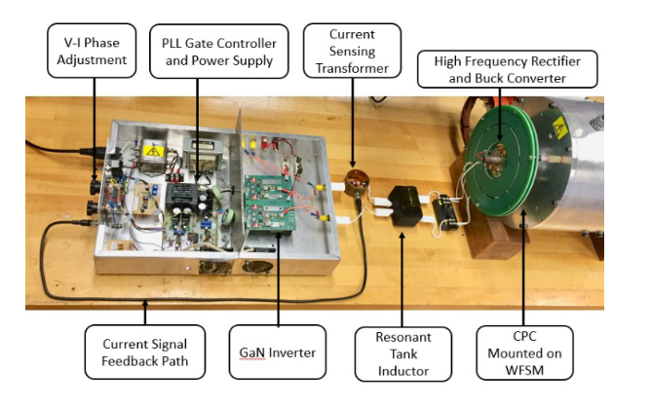
Aim : Merging Concurrent Power Transfer System with Slip Ring Applications
Contactless Slip Rings
Concurrent Power Transfer
Motivations:
To Increase power
To reduce switching components
To increase DC-link utilization rate
To provide operation for more than one standards
Motivations:
To eliminate carbon brushes requiring periodic maintenance
To eliminate brushless exciters that are not suitable for variable speed drives
Topologies:
Multi-converter and multi-resonant
Single-converter and multi-resonant
Single-converter and multi-load
Notes:
We talked about conventional systems.
In conventional IPT systems, the converter generates a square wave having multiple frequencies, and only the fundamental is transmitted via the resonant structure.
In literature, multifrequency IPT systems are also utilized.
The motivations for multifrequency can be listed as given.
For example, the third harmonic of the square wave is utilized via a multi-resonant structure and single converter.
Or, the system can be desired to operate more than frequency; multi-converter and multi-resonant can be utilized.
In my thesis, the WPT system is excited by motor drive.
It can be considered as a single-converter and multi-load system; the motivation is to reduce the switching components.
However, motor driving should be dynamic and requires a fast response.
Then, we should use conventional motor driving modulations.
In this condition, the main problem reveals.
How to control dual-frequency by conventional motor driving modulation.

Slide 6
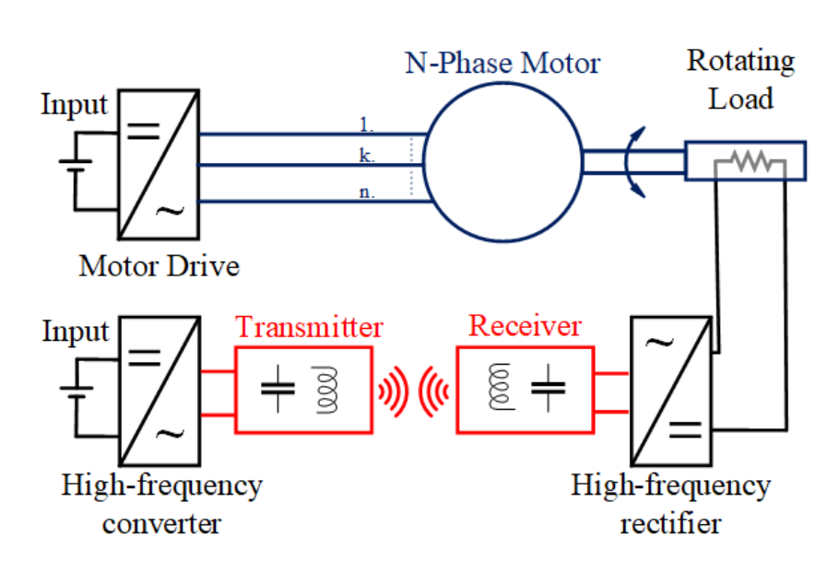
Conventional Inductive Power Transfer Based Contactless Slip Ring
Two converters:
To drive the motor
To excite the Tx coil
Motor → attenuated in motor current
The motor drive → generating low and high frequencies
Motor → used to drive
The WPT converter → generating high frequency
The WPT system →behaves like band-pass filter
Notes:
Our focus is on contactless slip rings.
Here, we have a representation of conventional contactless slip rings.
The common trait of these contactless slip rings; we have a motor drive system to achieve rotating load.
Inductive power transfer systems, a type of WPT system, are commonly used in such systems since they give a moderate transfer distance and higher efficiency.
IPT systems have four main parts: High-frequency converter, Transmitter, receiver, and high-frequency rectifier.
So, conventional contactless slip rings have two converters.
One of both is the converter of the motor drive.
Another is the high-frequency converter of the WPT system.
The motor drive also generates high-frequency switching components at the output, but the motor filters these components out.
A low-frequency modulating signal is used to drive the motor.
WPT converter generates high-frequency square waves, and Tx and Rx generally have band-pass filter characteristics.
Therefore, it only allows the desired high-frequency components to pass through.
Consequently, we have two converters in this system, which increase cost and complexity and decrease reliability.

Slide 7
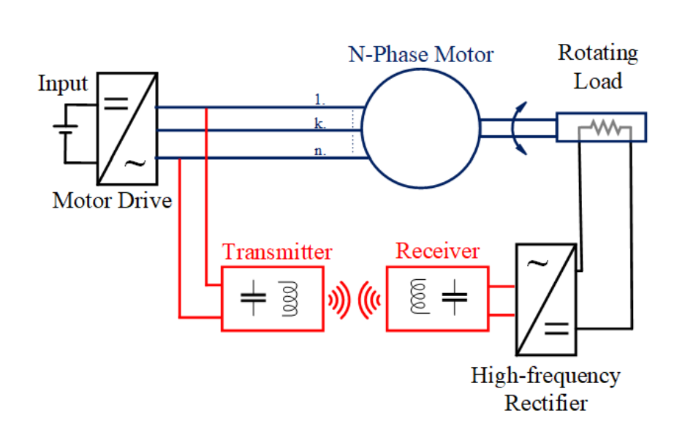
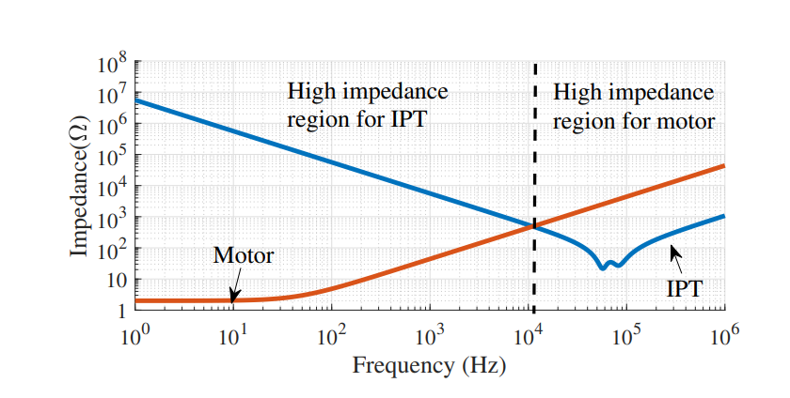
Proposed Inductive Power Transfer Based Contactless Slip Ring
The motor drive → generating high frequency
combining
The WPT system →behaves like band-pass filter
No longer required
The WPT converter → generating high frequency
Notes:
In the proposed system, the WPT system is excited by the motor drive’s high-frequency switching components.
Since the WPT system behaves like a band-pass filter, we do not observe the low-frequency modulating current.
Therefore, a separate WPT converter is no longer required.

Slide 8
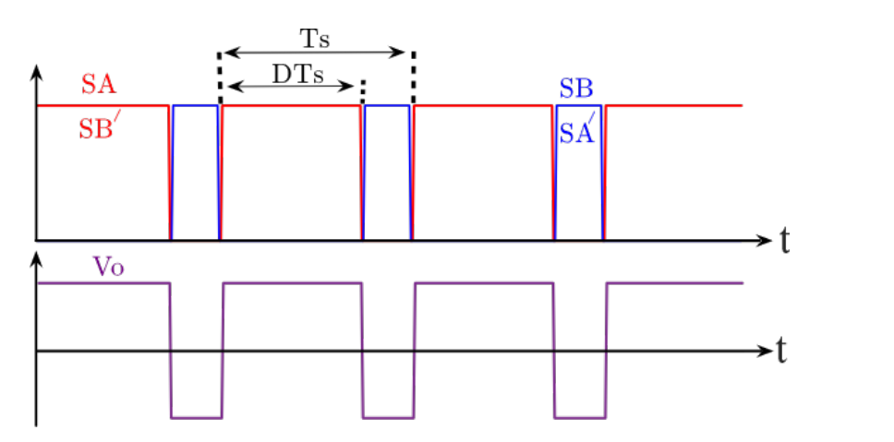
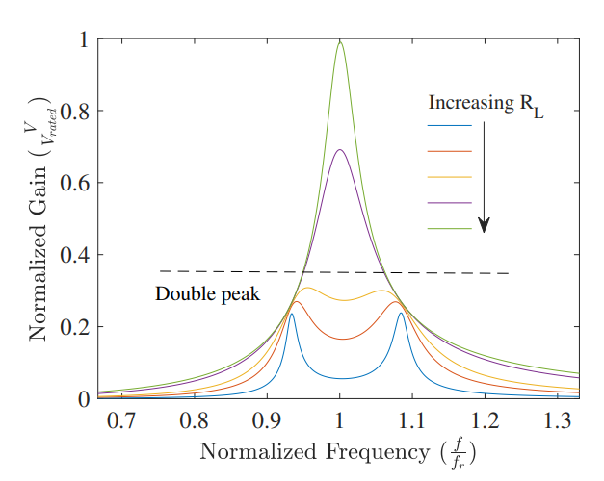
Challenge: Independent Control of Motor and Contactless Slip Ring Power
Motor:
DC motor
AC motor
WPT:
Transmitter (Primary Side) Control
Duty Cycle Control
Phase Shift Control
Switching Frequency Control
Receiver (Secondary Side) Control
Additional active converter
Active rectifier
Control:
Pulse Width Modulation
Unipolar PWM
Bipolar PWM
SPWM
SVPWM
DPWM
Notes:
We talked about conventional systems.
In conventional IPT systems, the converter generates a square wave having multiple frequencies, and only the fundamental is transmitted via the resonant structure.
In literature, multifrequency IPT systems are also utilized.
The motivations for multifrequency can be listed as given.
For example, the third harmonic of the square wave is utilized via a multi-resonant structure and single converter.
Or, the system can be desired to operate more than frequency; multi-converter and multi-resonant can be utilized.
In my thesis, the WPT system is excited by motor drive.
It can be considered as a single-converter and multi-load system; the motivation is to reduce the switching components.
However, motor driving should be dynamic and requires a fast response.
Then, we should use conventional motor driving modulations.
In this condition, the main problem reveals.
How to control dual-frequency by conventional motor driving modulation.

Slide 9
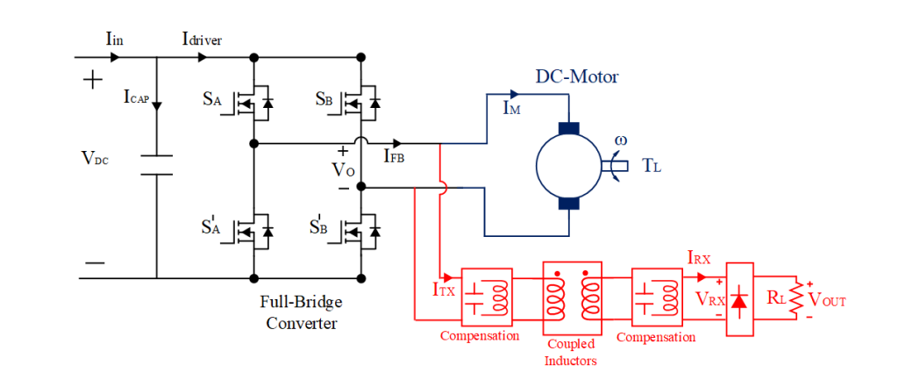
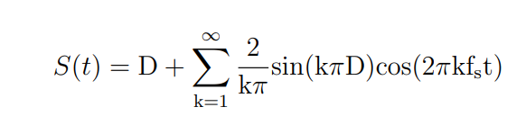
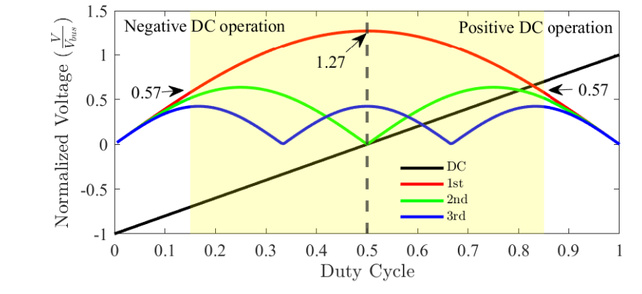

DC Motor Drives
$$S_{A}=S_{B}^{′}$$
Notes:
Let me start with DC motor drives.
In DC motor drives, we use a voltage source full-bridge converter, which is commonly used since it provides four-quadrant operation.
Since it is a voltage source converter, we can connect the WPT system in parallel, as shown in this figure.
Bi-polar PWM schemes are proffered as a PWM method, where SA and SB’ have the same signals.
The PWM signals are shown here; we change the DC voltage at the output by varying duty cycles.
According to the duty cycle, the DC and switching harmonics are shown here.
The duty cycle is changed to adjust the DC voltage; however, switching harmonics also vary.
However, we want to use these harmonics in the WPT system; therefore, the variation is compensated.
Further, we should limit our duty cycles since the switching harmonics approach 0 near the duty cycle is 0 or 1.

Slide 10
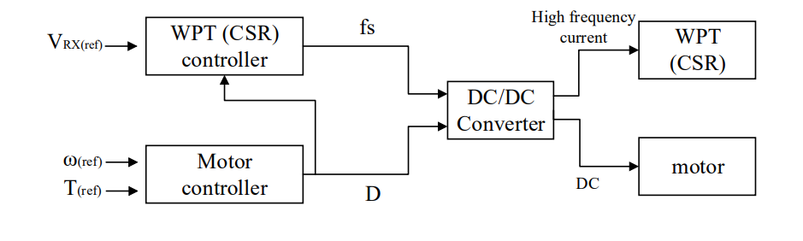
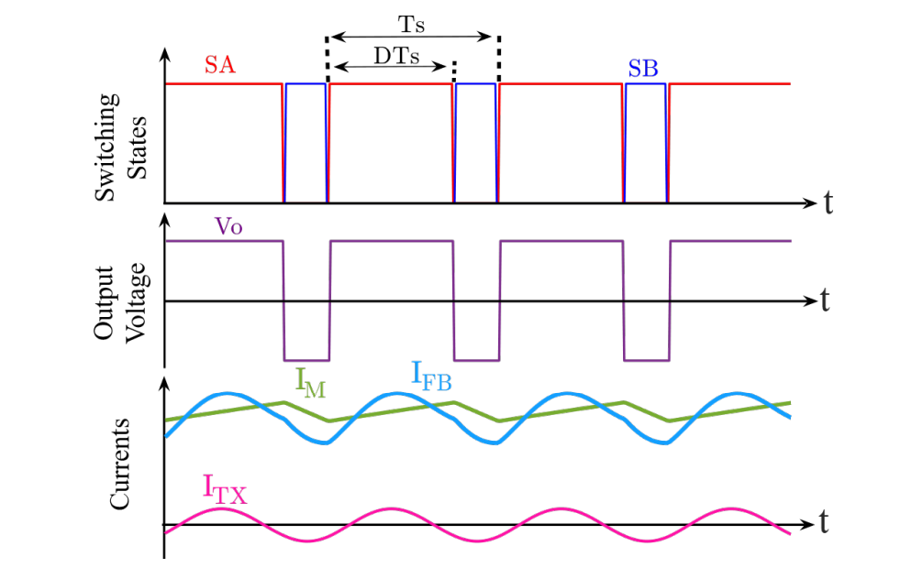
Control Method
Notes:
In the previous slide, we said that the switching harmonics vary with the duty cycle.
We introduce an independent control parameter, switching frequency, to control WPT power and keep it constant under any modulation.
The gain characteristics of the WPT system are shown; we can change the gain of the WPT system by switching frequency.
Switching frequency does not affect the motor operation since the motor time constant is large.
By applying appropriate frequency, we keep the WPT power independent of the duty cycle.
The switching signals, output voltage, and current waveforms are shown here.
The WPT system has lower ratings than the motor, and the current is much smaller than the motor current.
Therefore, the converter current does not look completely different from the motor current.

Slide 11
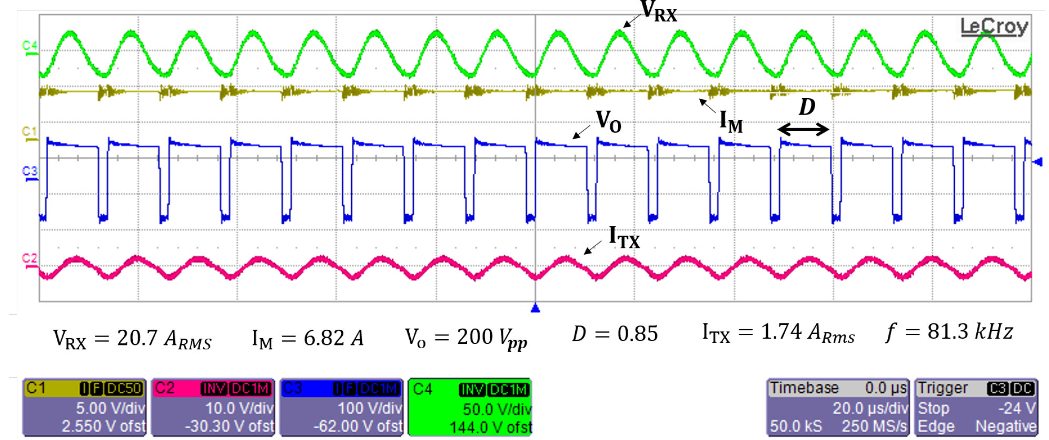
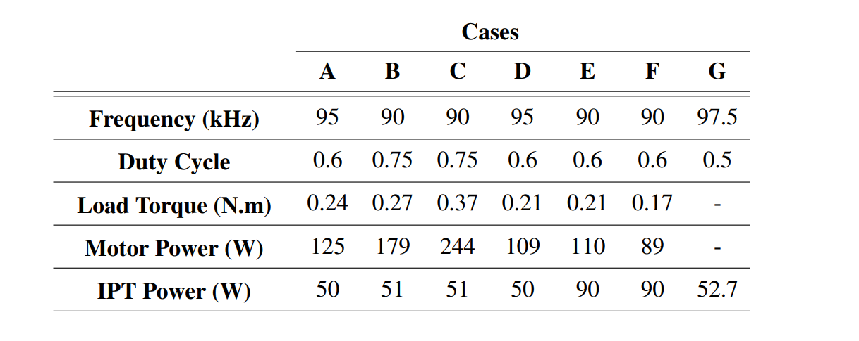
Concurrent Operation
Notes:
In order to validate the concurrent operation.
Firstly, only the WPT system is connected. The switching frequency is 81.3 kHz, the duty cycle is 0.85, and its output voltage is 20.8V.
Then, only the motor is connected to the motor drive for the same duty cycle and switching frequency.
The motor drive delivers 480W. After, the WPT and motor are connected together.
It is observed that the motor and WPT supply the power as the stand-alone connection.
Therefore, we can say that the concurrent operation can be done by applying the appropriate duty cycle and switching frequency.
In the thesis, the concurrent operation is tested under several duty cycles and switching frequencies to observe the continuous power transfer.

Slide 12
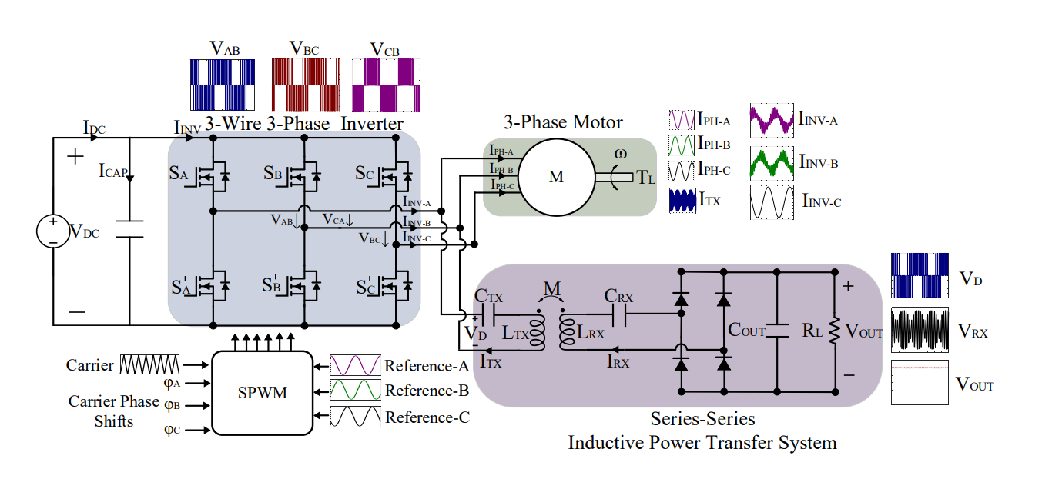
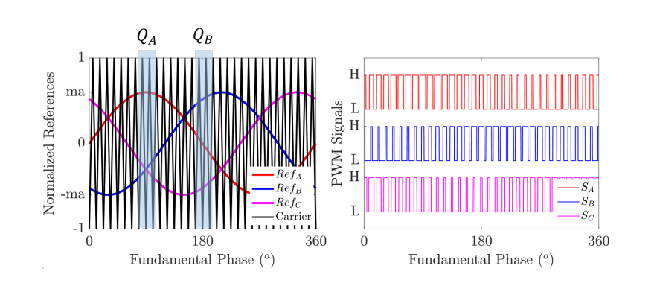
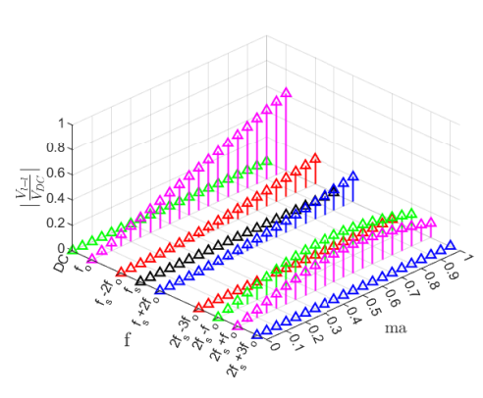
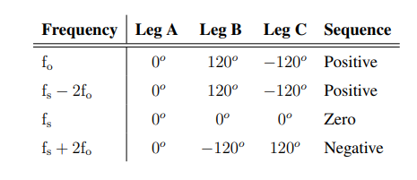
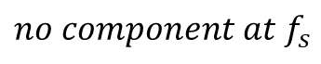
AC Motor Drives
There is no transferred power at some time points if only side band exist
$$no component at f_{s}$$
Notes:
In AC motor drives, we use a 3-wire 3-phase voltage source inverter.
SPWM is applied to generate a required voltage waveform at the inverter output.
We have sinusoidal reference signals that are compared with triangular carrier signals, creating PWMs.
In standard SPWM, line-to-line voltage harmonic distribution is shown.
There is no component at the switching frequency since the switching frequency, and sidebands create zero/positive/ negative sequences.
In this condition, we can not control the switching harmonic, so the WPTs power.
In the proposed system, we can give a phase shift to the carrier signals to eliminate the zero sequences.

Slide 13
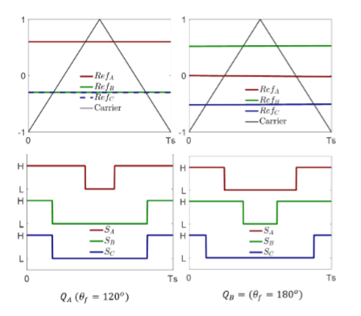
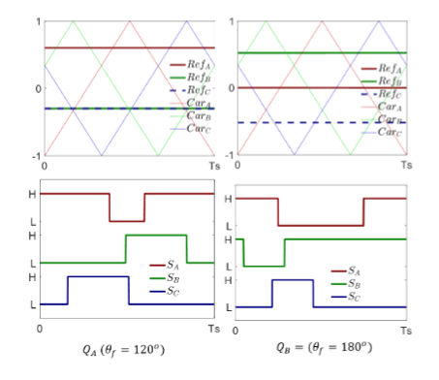
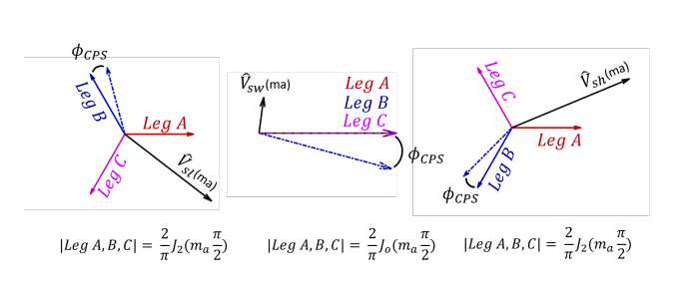
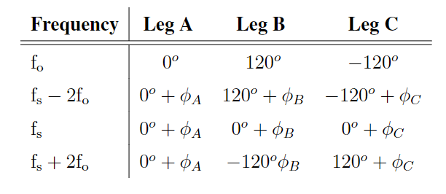
Carrier Phase Shift
Notes:
In AC motor drives, we use a 3-wire 3-phase voltage source inverter.
SPWM is applied to generate a required voltage waveform at the inverter output.
We have sinusoidal reference signals that are compared with triangular carrier signals, creating PWMs.
In standard SPWM, line-to-line voltage harmonic distribution is shown.
There is no component at the switching frequency since the switching frequency, and sidebands create zero/positive/ negative sequences.
In this condition, we can not control the switching harmonic, so the WPTs power.
In the proposed system, we can give a phase shift to the carrier signals to eliminate the zero sequences.

Slide 14
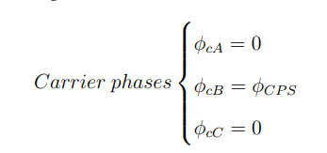
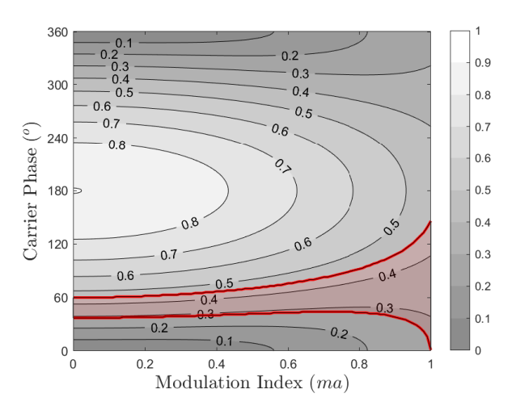
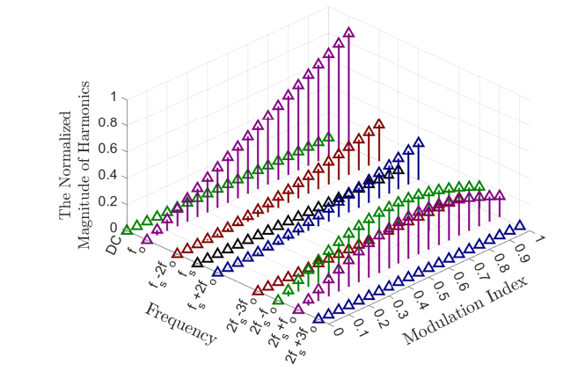
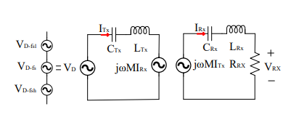
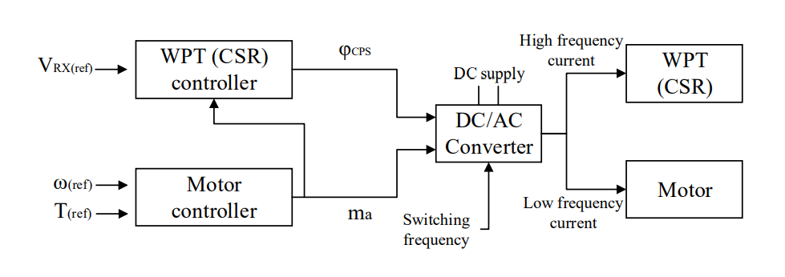
Primary Side Voltage Control
Notes:
The WPT system is connected between phase-A and phase B.
By carrier phase shift to phase B, we achieve this contour of the magnitude of the switching frequency.
We can observe that we can have a constant gain for any modulation.
The constant gain is between 0.25 and 0.45 over a DC-link voltage.
The control diagram is shown.
We adjust the carrier phase shift according to modulation to control the WPT power.

Slide 15
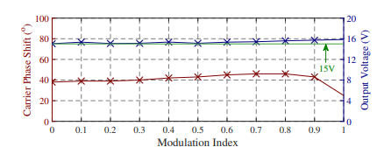
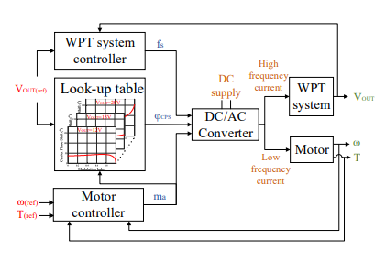
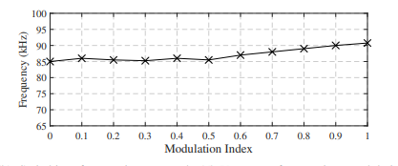
Output Voltage Regulation
Notes:
The WPT system is connected between phase-A and phase B.
By carrier phase shift to phase B, we achieve this contour of the magnitude of the switching frequency.
We can observe that we can have a constant gain for any modulation.
The constant gain is between 0.25 and 0.45 over a DC-link voltage.
The control diagram is shown.
We adjust the carrier phase shift according to modulation to control the WPT power.

Slide 16
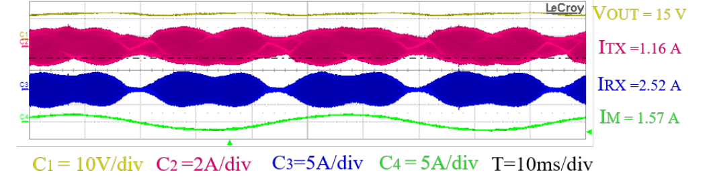
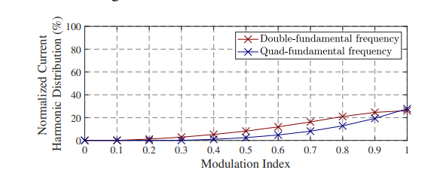
Low-frequency Ripple at the Output Voltage
Notes:
The WPT system is connected between phase-A and phase B.
By carrier phase shift to phase B, we achieve this contour of the magnitude of the switching frequency.
We can observe that we can have a constant gain for any modulation.
The constant gain is between 0.25 and 0.45 over a DC-link voltage.
The control diagram is shown.
We adjust the carrier phase shift according to modulation to control the WPT power.

Slide 17
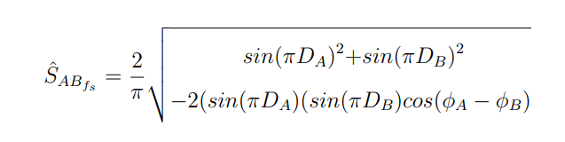
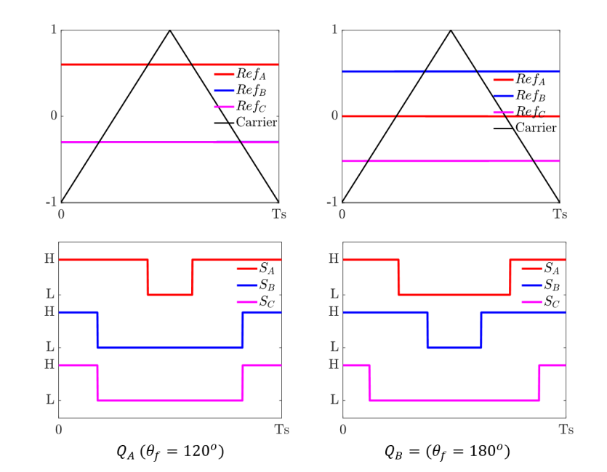
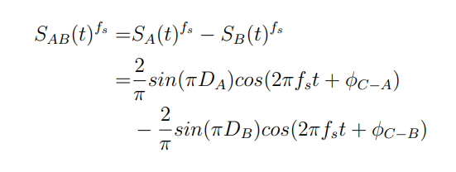
Real-time algorithm
Notes:
So, a new idea is revealed here.
Real-time control of the switching frequency to keep the magnitude constant.
The switching component magnitudes change over a fundamental frequency in each operation point.
Therefore, we can calculate the carrier phase shift value for each switching interval before applying the PWMs.
And we achieve a constant magnitude at the WPT system.
The carrier phase shift can be calculated by Fourier series and phasor domain sum, as seen in these equations.

Slide 18
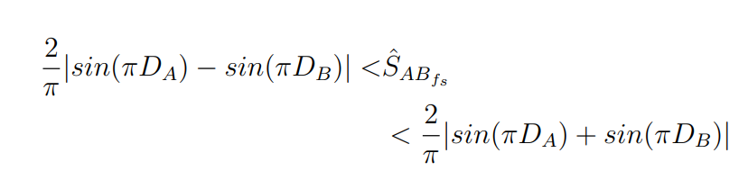
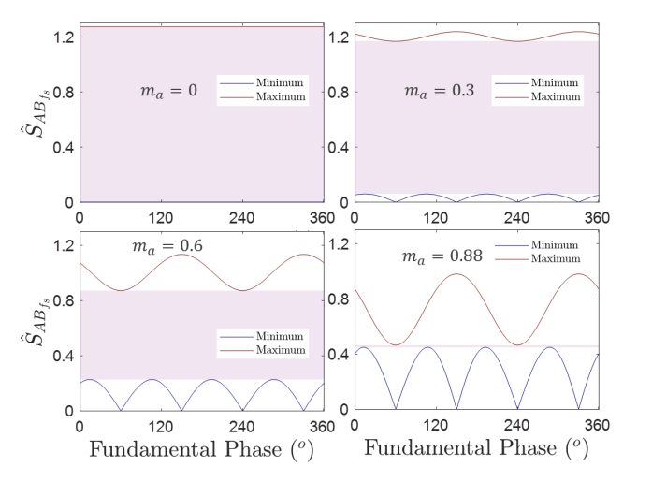
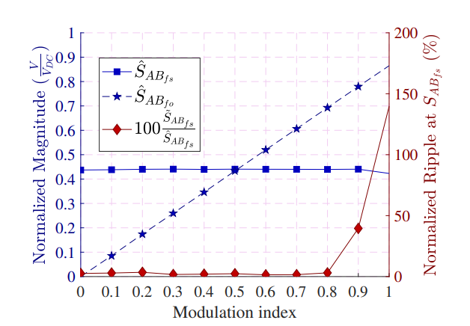
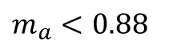

Restrictions
${\hat{S}}_{AB_{fs}}=0.43 !$
$m_{a}<0.88$
Notes:
However, in these conditions, also we have some restrictions.
Since the duty cycle at any time is dependent the motor modulation, so SPWM, We cannot achieve some voltages.
These figures draw the maximum and minimum voltage gains for several modulation indexes.
Maximum voltages actually correspond to 180-degree carrier phase shift, while minimum voltage corresponds to 0 degrees.
As can be observed graphically, we can achieve a 0.43 gain over a fundamental frequency for every modulation index below 0.85.
To avoid low-frequency fluctuation, we can restrict our modulation index.

Slide 19
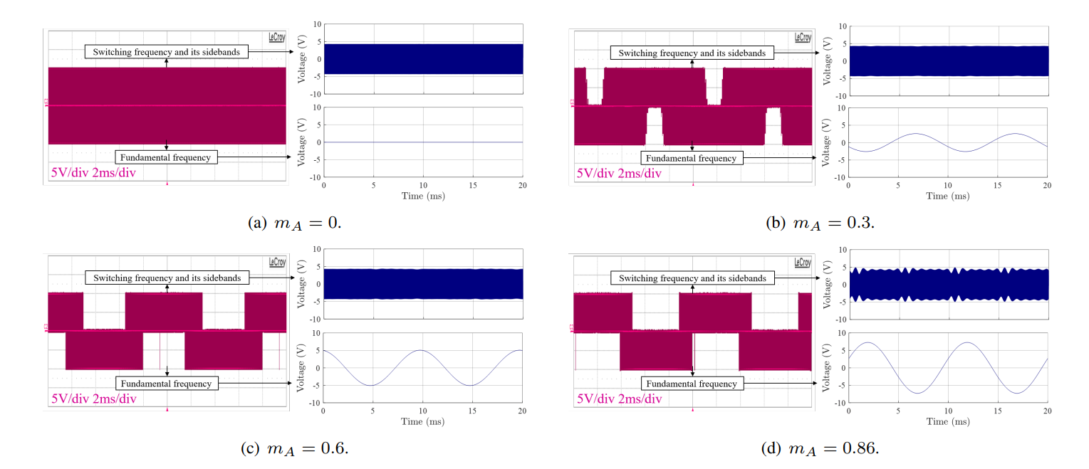
Experimental Validation
Notes:
The WPT system is connected between phase-A and phase B.
By carrier phase shift to phase B, we achieve this contour of the magnitude of the switching frequency.
We can observe that we can have a constant gain for any modulation.
The constant gain is between 0.25 and 0.45 over a DC-link voltage.
The control diagram is shown.
We adjust the carrier phase shift according to modulation to control the WPT power.

Slide 20
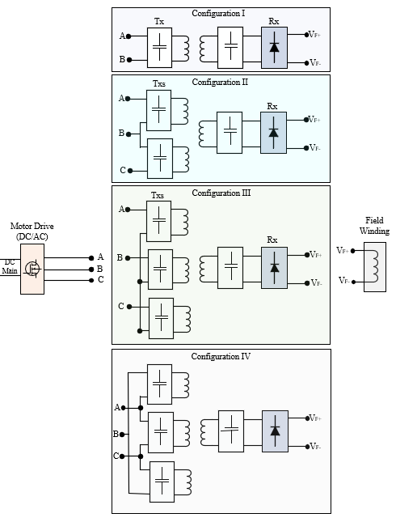
Future Works
Motor drives have more than 2 wires
Conventional WPT systems have 2 wires input
Multi-phase WPT systems
Motivations:
To increase DC-link utilization rate
To increase power
To break the restrictions
Notes:
The WPT system is connected between phase-A and phase B.
By carrier phase shift to phase B, we achieve this contour of the magnitude of the switching frequency.
We can observe that we can have a constant gain for any modulation.
The constant gain is between 0.25 and 0.45 over a DC-link voltage.
The control diagram is shown.
We adjust the carrier phase shift according to modulation to control the WPT power.

Slide 21
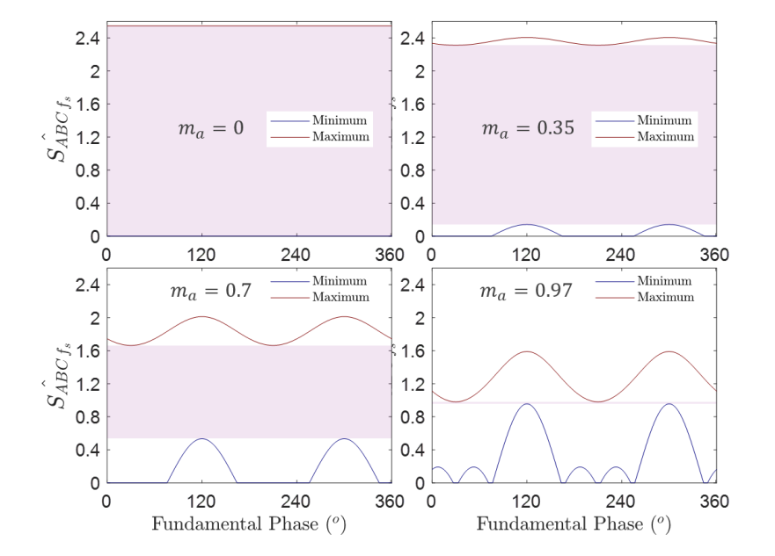
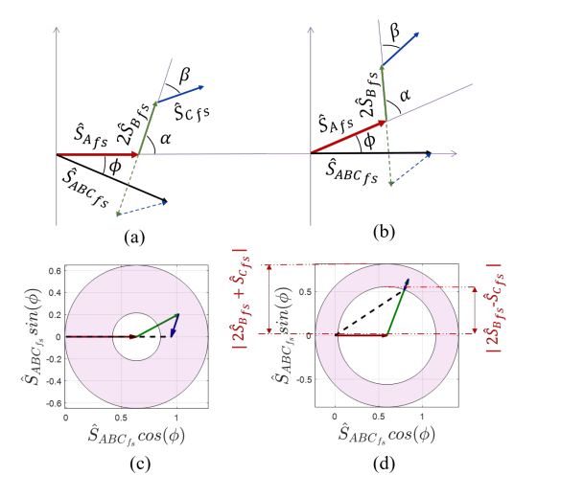
Future Works
Notes:
The WPT system is connected between phase-A and phase B.
By carrier phase shift to phase B, we achieve this contour of the magnitude of the switching frequency.
We can observe that we can have a constant gain for any modulation.
The constant gain is between 0.25 and 0.45 over a DC-link voltage.
The control diagram is shown.
We adjust the carrier phase shift according to modulation to control the WPT power.

Slide 22
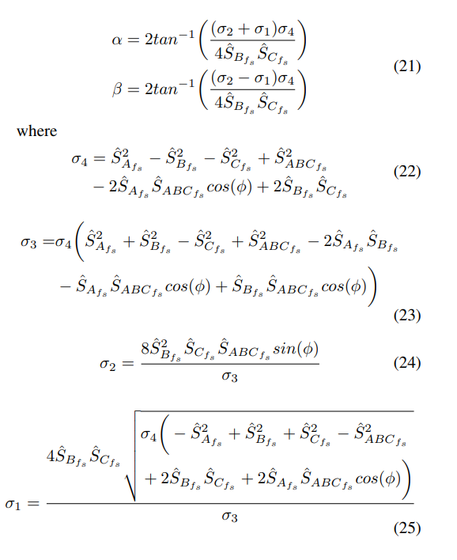
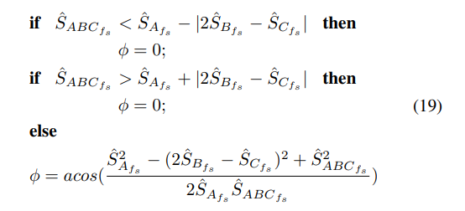
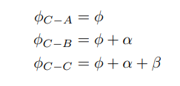
Challenge- Calculation Burden!
Notes:
The WPT system is connected between phase-A and phase B.
By carrier phase shift to phase B, we achieve this contour of the magnitude of the switching frequency.
We can observe that we can have a constant gain for any modulation.
The constant gain is between 0.25 and 0.45 over a DC-link voltage.
The control diagram is shown.
We adjust the carrier phase shift according to modulation to control the WPT power.

Slide 23
Thanks!

Slide 24
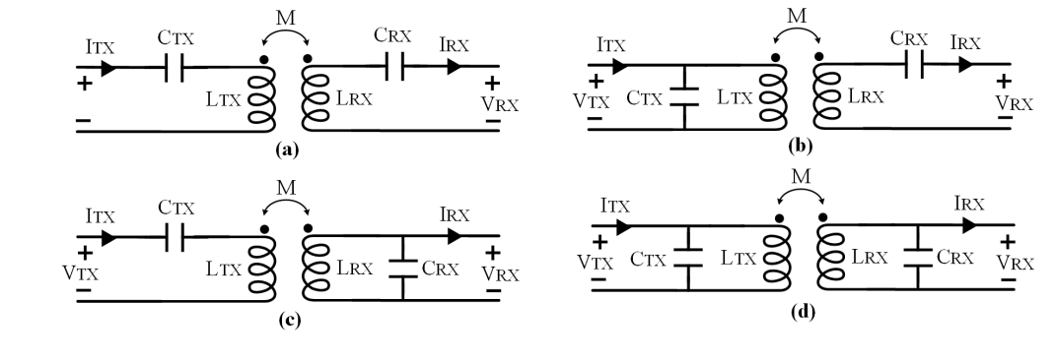
Compensation Topologies
Series-Series Compensation
Source Type | Voltage Source
Resonant frequency | Load Independent
Resonant frequency | Coupling Independent
No load operation | Short Circuit
Capacitor Size | Large
a) Series-series
b) Parallel-series
c) Series-parallel
d) Parallel-parallel

Slide 25


Zero Voltage Switching
Inductive region → The capacitance of the switches discharges by the load current during dead time.

Slide 26




Bifurcation Phenomenon
Double-peak
$f_{op}>f_{r}$→ Inductive region
Making control difficult
Decreasing efficiency

Slide 27











Wireless Power Transfer System Design Procedure
$$0.15 < D< 0.85$$
$40 V_{RMS}$< $V_{o,1^{st}}(rms)$< $90 V_{RMS}$
$$D=0.15$$
$$D=0.5$$
$$D=0.85$$
$$k$$
Notes:
The system ratings are presented here.
Before the design stage of the WPT system, the DC-link voltage and duty cycle limits are important.
The duty cycle is limited between 0.15 and 0.85, which means that the minimum voltage at the switching frequency is 40V.
The maximum voltage is reached at D=0.5, which gives 90V.
Therefore, the WPT system should give the desired power for these input variations, which is compensated by frequency control.
Coupling and quality factors are design parameters, and we can calculate the parameters as given.

Slide 28


Wireless Power Transfer System Design

Slide 29









Wireless Power Transfer System Design

Slide 30


Wireless Power Transfer System Design

Slide 31


Experimental Results- WPT System Validation
Notes:
The design and measured values are presented here.
The WPT system is tested for different duty cycles and switching frequencies.
The contour of the output power over the duty cycle and switching frequency is plotted.
We can observe iso-power lines. We choose the outer iso-power line, which can supply the desired power under any given duty cycle.

Slide 32







Wireless Power Transfer System Design

